Slide 1


Modeling of
Aeroservoelastic Systems
Anthony Su
11/30/2023

Slide 2
Agenda
Overview
FEM & GVT
State-Space Modeling
Wind Tunnel Testing
Model Tuning & Optimization
Conclusion

Slide 3
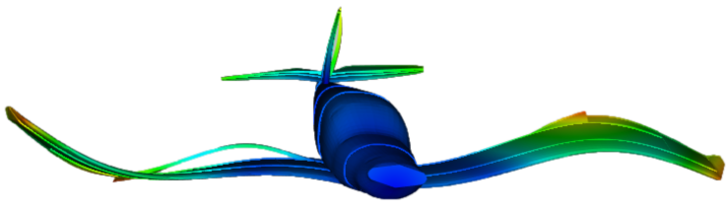
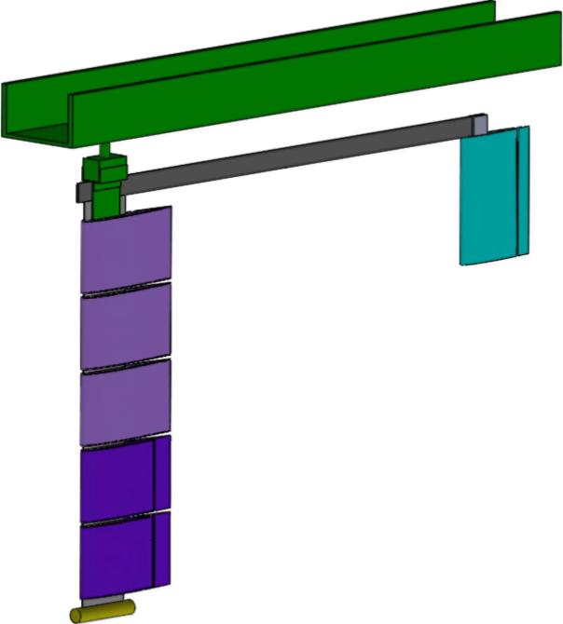
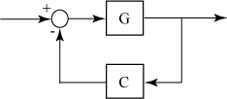
Overview
AEROSERVO-
ELASTICITY
MARGE
MODELING
Structural Dynamics
Aerodynamics
Controls
Model for Aeroelastic Response to Gust Excitation
Physics-based model
Required for active control
https://www.m4-engineering.com/wp-content/uploads/2020/04/pynastran-2.png
Notes:
Aeroservoelasticity
structural dynamics, aerodynamics, and controls
important because energy-efficient aircraft have long, slender wings which are flexible
the most flexible wings must actively counteract bending and twisting in real-time
MLA, GLA, and flutter suppression
MARGE
MARGE is the test article that is modeled and tested in this project
short for Model for Aeroelastic Response to Gust Excitation
Modeling
The objective of this project was to synthesize a physics-based state-space model of MARGE
Physics-based “grey-box” models are (in theory) more interpretable and generalizable than traditional black-box system identification methods
This model can then be used for control design to do the aforementioned things (MLA, GLA, flutter suppression)

Slide 4
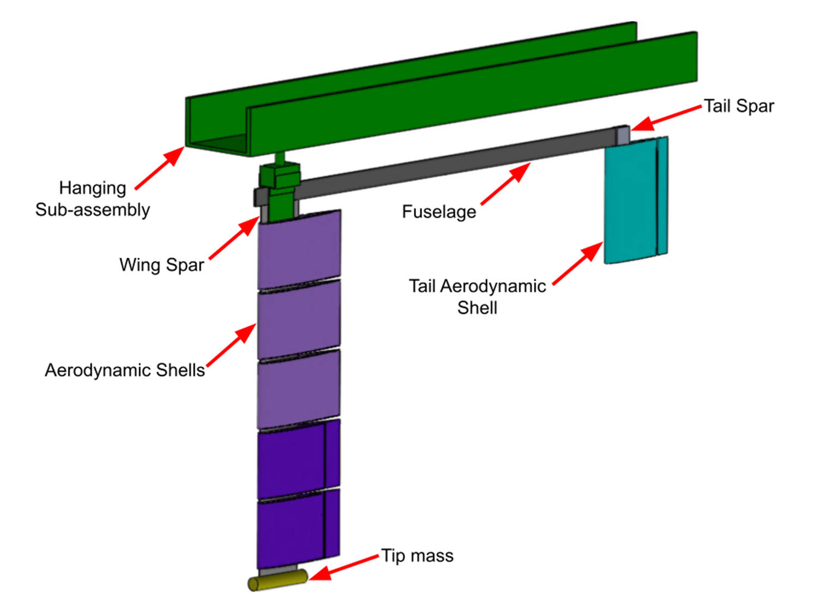
Overview
MARGE
Model for Aeroelastic Response to Gust Excitation¹
Low-cost
Highly flexible
Rotates freely in pitch
Notes:
<insert>

Slide 5
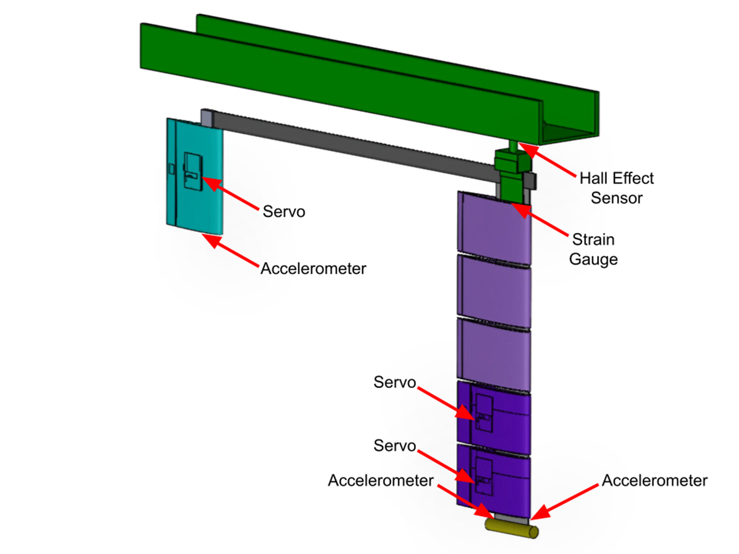
Overview
MARGE
Model for Aeroelastic Response to Gust Excitation¹
Low-cost
Highly flexible
Rotates freely in pitch
5 on-board sensors
3 on-board actuators
Notes:
<insert>

Slide 6
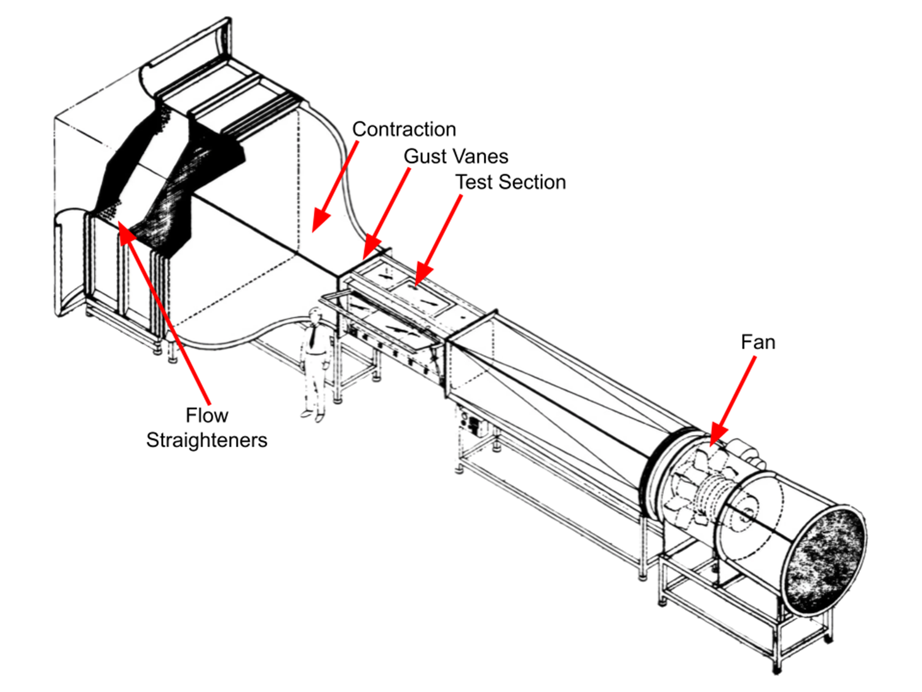
Overview
MARGE
Model for Aeroelastic Response to Gust Excitation¹
Low-cost
Highly flexible
Rotates freely in pitch
5 on-board sensors
3 on-board actuators
3x3 Wind Tunnel
twin controllable upstream gust vanes
Notes:
MARGE is designed to be tested in the UW 3x3 wind tunnel
Wind blows from top left to bottom right in this image
Upstream of where MARGE is mounted are two gust vanes which can create unsteady flow fields around MARGE

Slide 7




FEM & GVT
structural dynamic modal information
existing NASTRAN model
GVT
<insert>
<insert>

Slide 8
FEM & GVT
NASTRAN FEM
Spars: Linear beam elements
Fuselage: Linear beam elements
Panels: Rigid elements
Notes:
<insert>
disclaimer: I didn’t make the NASTRAN model

Slide 9
FEM & GVT
NASTRAN FEM
Spars: Linear beam elements
Fuselage: Linear beam elements
Panels: Rigid
Vanes: Rigid
Tunnel: Rigid
Aerodynamics: Linear unsteady
Spline interpolation
Notes:
<insert>

Slide 10
FEM & GVT
GVT
mode shape animation
<insert>
<insert>
<insert>
<insert>
Notes:
<insert>

Slide 11
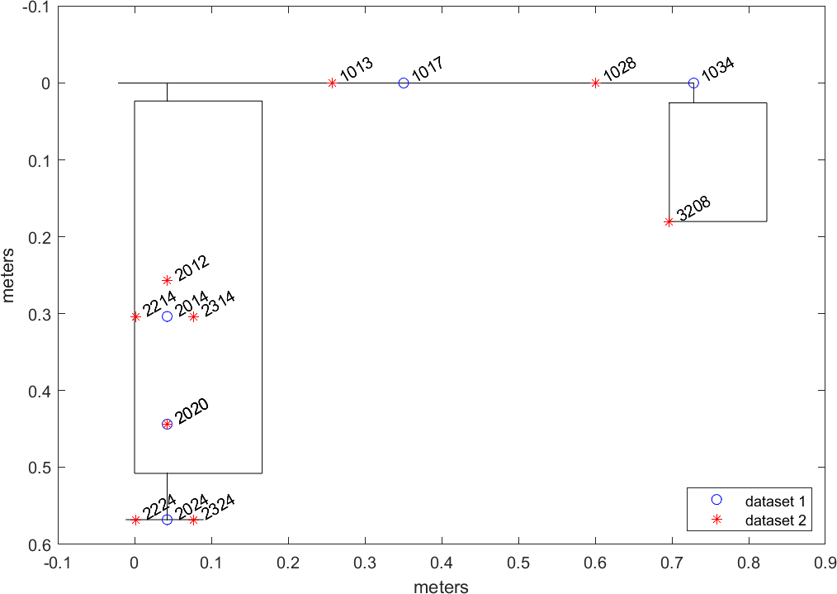
FEM & GVT
GVT
<insert>
<insert>
<insert>
<insert>
Notes:
<insert>

Slide 12
FEM & GVT
GVT
GVT time-series
<insert>
<insert>
<insert>
<insert>
<insert>
<insert>
Notes:
<insert>

Slide 13
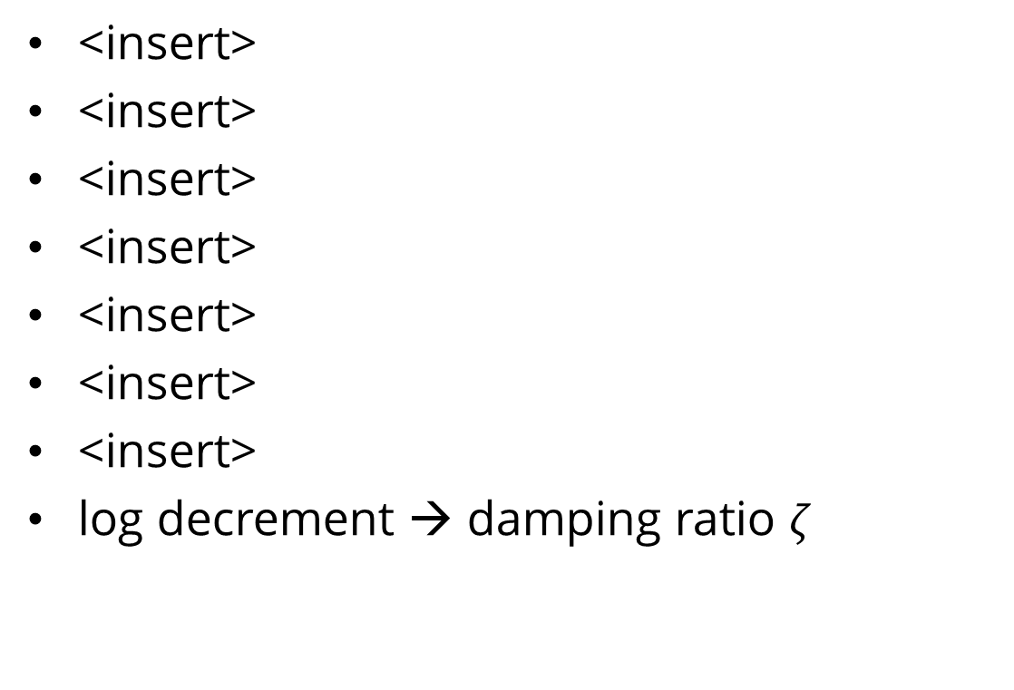
FEM & GVT
GVT
GVT FRF equations
<insert>
<insert>
<insert>
<insert>
<insert>
<insert>
<insert>
log decrement → damping ratio $ζ$
Notes:
<insert>

Slide 14
State-Space
Modeling
<insert>
<insert>

Slide 15
Modeling
Structural Dynamics
structural dynamic EOM
<insert>
<insert>
<insert>
<insert>
Notes:
<insert>
disclaimer: I didn’t make the NASTRAN model

Slide 16
Modeling
Aerodynamics
Theodorsen solution
Roger approximation
<insert>
<insert>
<insert>
<insert>
Notes:
<insert>
disclaimer: I didn’t make the NASTRAN model

Slide 17
Modeling
Actuators & Sensors
Theodorsen Solution
Roger Approximation
<insert>
<insert>
<insert>
<insert>
Coupled Aeroservoelasticity
<insert>
<insert>
<insert>
<insert>
Notes:
<insert>
disclaimer: I didn’t make the NASTRAN model

Slide 18
Modeling
full state-space model block diagram
Notes:
Aeroservoelasticity
structural dynamics, aerodynamics, and controls
important because energy-efficient aircraft have long, slender wings which are flexible
the most flexible wings must actively counteract bending and twisting in real-time
MLA, GLA, and flutter suppression
MARGE
MARGE is the test article that is modeled and tested in this project
short for Model for Aeroelastic Response to Gust Excitation
Modeling
The objective of this project was to synthesize a physics-based state-space model of MARGE
This model can then be used for control design to do the aforementioned things (MLA, GLA, flutter suppression)

Slide 19
Wind Tunnel Testing
<insert>
<insert>

Slide 20
Wind Tunnel
Setup
structural dynamic EOM
<insert>
<insert>
<insert>
<insert>
Notes:
<insert>
disclaimer: I didn’t make the NASTRAN model

Slide 21
Wind Tunnel
Setup
structural dynamic EOM
<insert>
<insert>
<insert>
<insert>
Notes:
<insert>
disclaimer: I didn’t make the NASTRAN model

Slide 22
Wind Tunnel
wind tunnel FRFs
Notes:
Aeroservoelasticity
structural dynamics, aerodynamics, and controls
important because energy-efficient aircraft have long, slender wings which are flexible
the most flexible wings must actively counteract bending and twisting in real-time
MLA, GLA, and flutter suppression
MARGE
MARGE is the test article that is modeled and tested in this project
short for Model for Aeroelastic Response to Gust Excitation
Modeling
The objective of this project was to synthesize a physics-based state-space model of MARGE
This model can then be used for control design to do the aforementioned things (MLA, GLA, flutter suppression)

Slide 23
Model Tuning
<insert>
<insert>

Slide 24
Model Tuning
Hand Tuning
structural dynamic EOM
<insert>
<insert>
<insert>
<insert>
Notes:
<insert>
disclaimer: I didn’t make the NASTRAN model

Slide 25
Model Tuning
Optimization
structural dynamic EOM
<insert>
<insert>
<insert>
<insert>
Notes:
<insert>
disclaimer: I didn’t make the NASTRAN model

Slide 26
Model Tuning
some visualization of the optimization result (?)
Notes:
Aeroservoelasticity
structural dynamics, aerodynamics, and controls
important because energy-efficient aircraft have long, slender wings which are flexible
the most flexible wings must actively counteract bending and twisting in real-time
MLA, GLA, and flutter suppression
MARGE
MARGE is the test article that is modeled and tested in this project
short for Model for Aeroelastic Response to Gust Excitation
Modeling
The objective of this project was to synthesize a physics-based state-space model of MARGE
This model can then be used for control design to do the aforementioned things (MLA, GLA, flutter suppression)

Slide 27
Conclusion
<summary>
<results>
<impact
<future work>
<acknowledgements>
<…>

Slide 28
References
[1] Jake D. Quenzer, Alison Zongolowicz, Kimberly A. Hinson, Bijan Barzgaran, Eli Livne, Mehran Mesbahi, and Kristi Morgansen. Model for Aeroelastic Response to Gust Excitation. American Institute of Aeronautics and Astronautics Inc., 2019.
[2]
[3]
[4]
[5]
[6]

Slide 29


ENCODE
SANS

Slide 30
FONT GUIDE
Headings:
ENCODE SANS NORMAL BLACK, ALL CAPS
Alternate headlines and subheads:
UNI SANS BOOK, ALL CAPS
Bodies: Open sans and Open sans bold

Slide 31
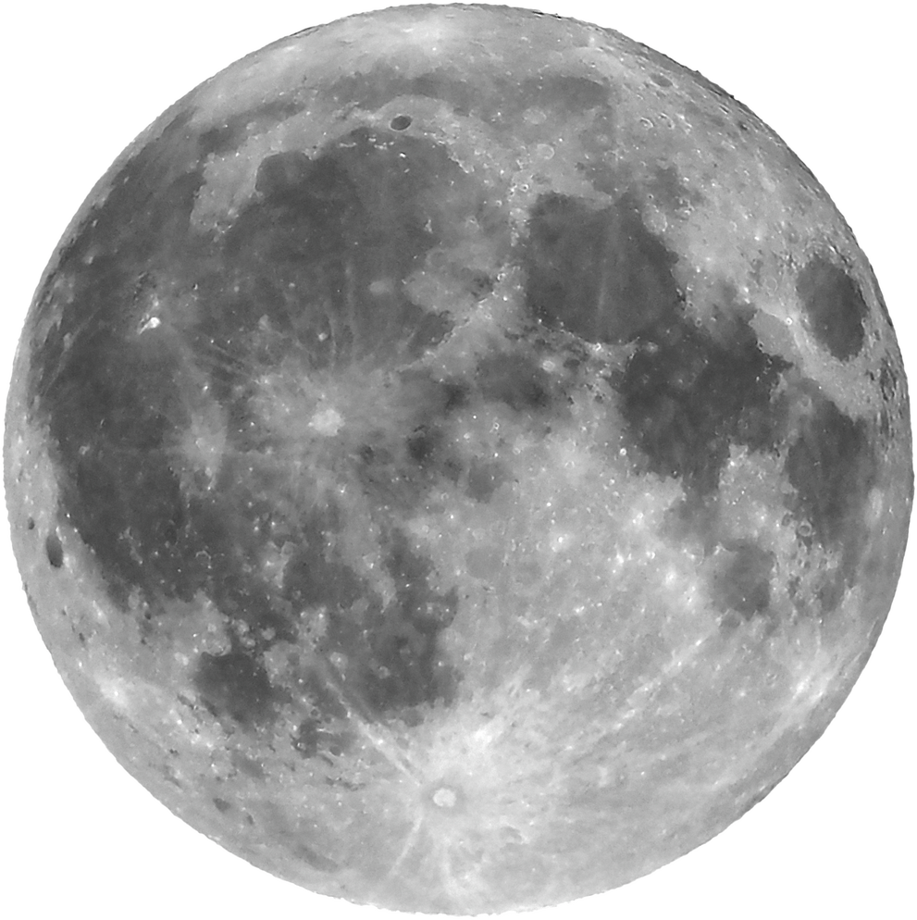

1
Open sans regular body
ENCODE
SANS
2
Or open sans bold body
UNI SANS
(SUBHEADING)

Slide 32
ENCODE SANS HEADING
UNI SANS SUBHEADING
87%
Briefly elaborate on what you want to discuss.
Briefly elaborate on what you want to discuss.

Slide 33
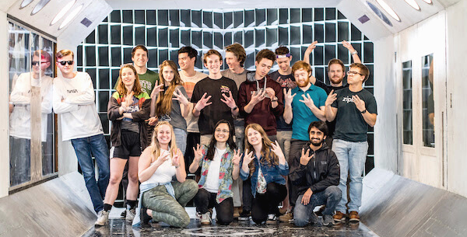
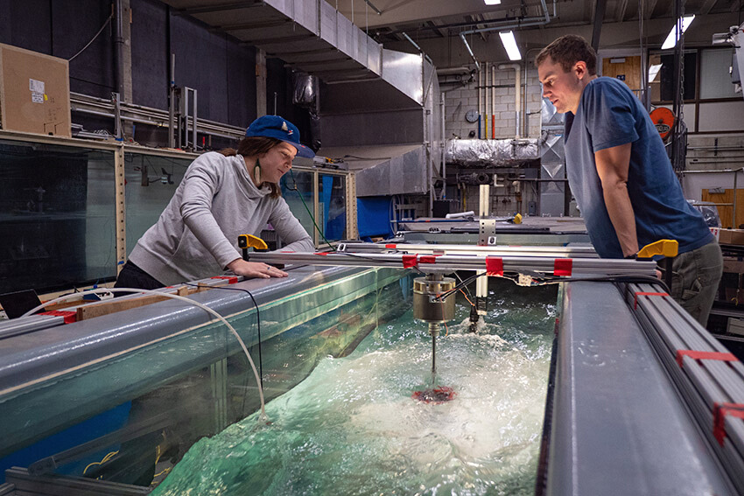
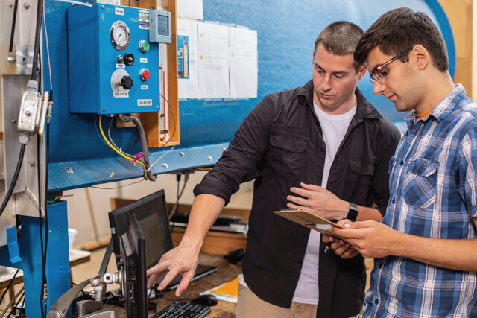
ENCODE SANS HEADING
Open sans body Open sans body Open sans body Open sans body Open sans body Open sans body Open sans body Open sans body Open sans body
1
2
3
Open sans body
Open sans body
Open sans body
Open sans body
Open sans body
Open sans body
Open sans body
Open sans body
Open sans body
Open sans body
Open sans body
Open sans body
Open sans body
Open sans body
Open sans body
Open sans body
Open sans body
Open sans body

Slide 34

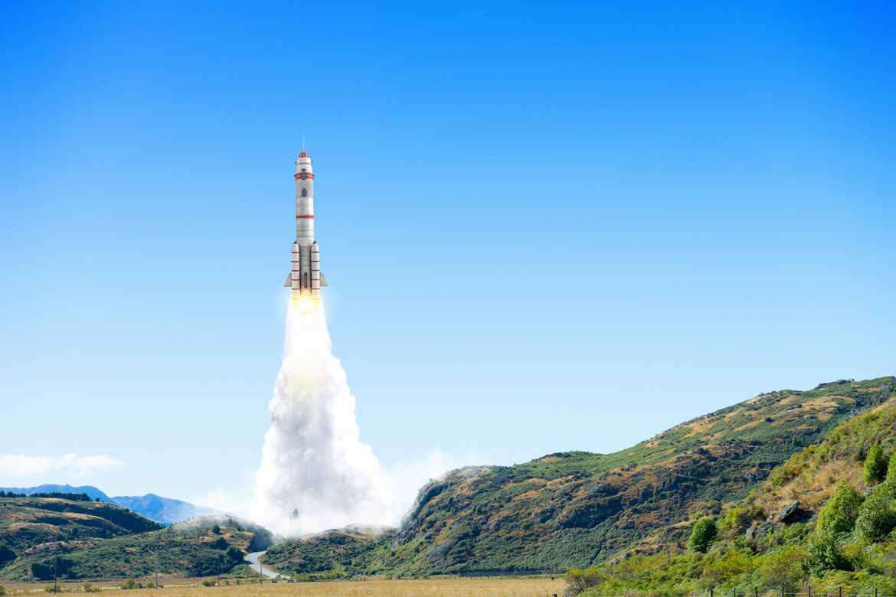
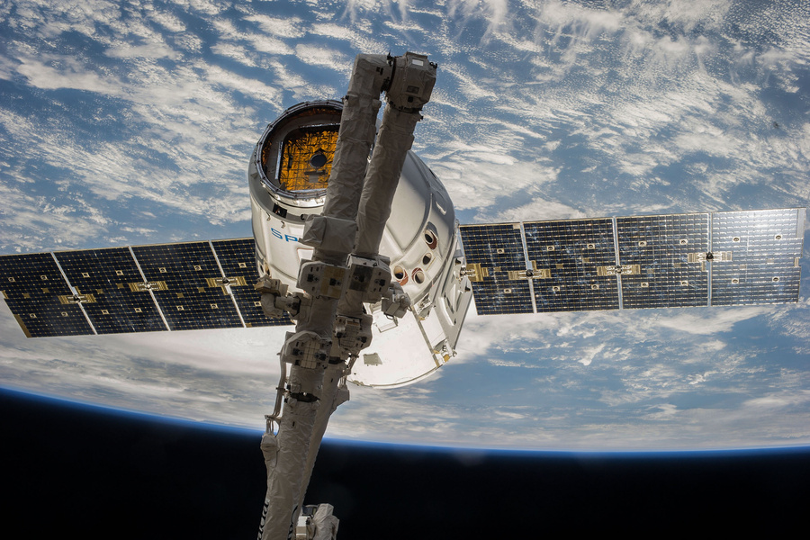
ENCODE SANS HEADING
Open sans body Open sans body Open sans body Open sans body Open sans body Open sans body Open sans body Open sans body
UNI SANS
UNI SANS
UNI SANS
Open sans body Open sans body Open sans body Open sans body Open sans body Open sans body
Open sans body Open sans body Open sans body Open sans body Open sans body Open sans body
Open sans body Open sans body Open sans body Open sans body Open sans body Open sans body

Slide 35

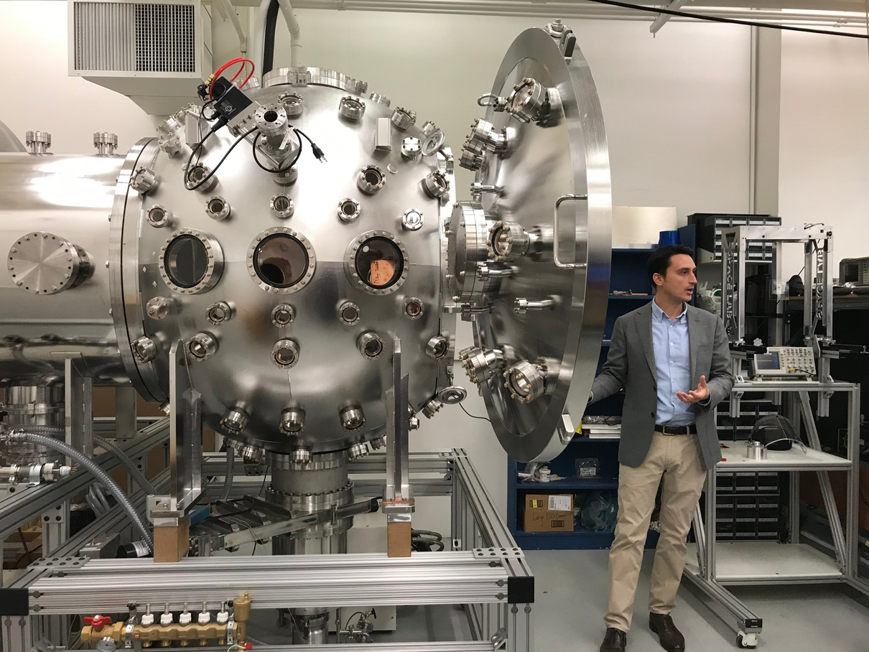
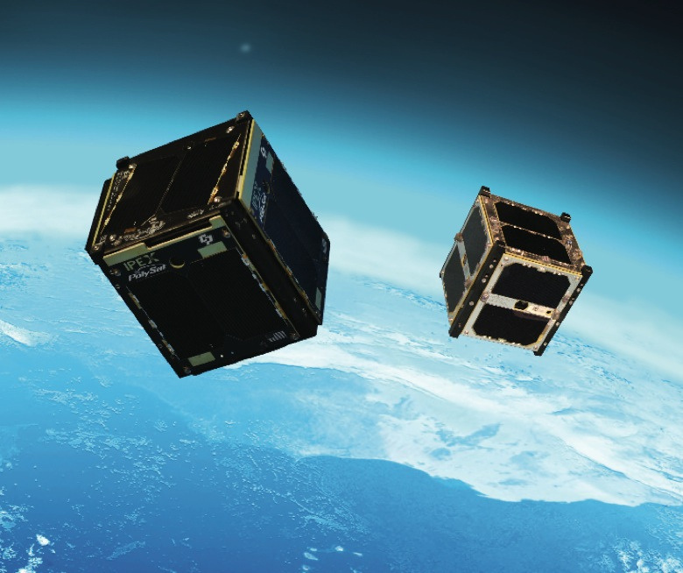

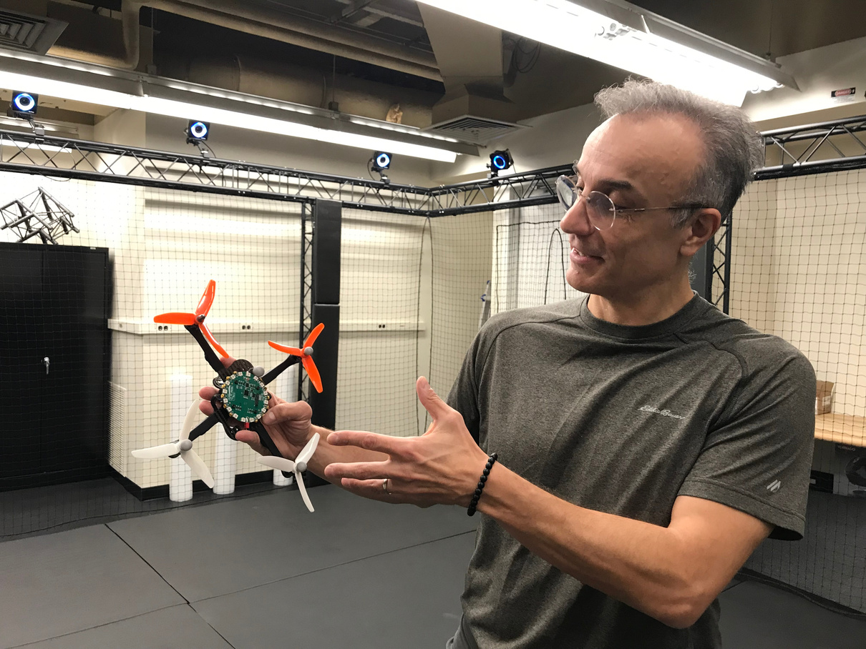
ENCODE SANS
UNI SANS SUBHEADING
Open sans body Open sans body Open sans body Open sans body Open sans body Open sans body Open sans body Open sans body Open sans body Open sans body
Open sans body Open sans body Open sans body Open sans body Open sans body Open sans body Open sans body Open sans body Open sans body Open sans body

Slide 36
break

Slide 37

ENCODE SANS HEADING
UNI SANS SUBHEADING

Slide 38
01
UNI SANS
Open sans body Open sans body Open sans body Open sans body Open sans body Open sans body
UNI SANS
ENCODE
SANS
Open sans body Open sans body Open sans body Open sans body Open sans body Open sans body
UNI SANS
Open sans body Open sans body Open sans body Open sans body Open sans body Open sans body

Slide 39

ENCODE SANS HEADING
02
UNI SANS SUBHEADING
Open sans body Open sans body Open sans body Open sans body Open sans body Open sans body Open sans body

Slide 40
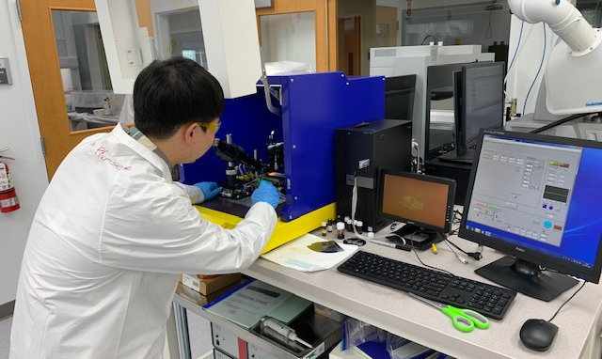
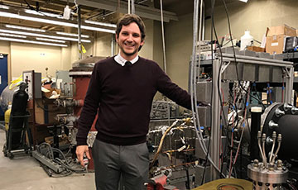
UNI SANS
Open sans body Open sans body Open sans body Open sans body Open sans body
UNI SANS
Open sans body Open sans body Open sans body Open sans body Open sans body

Slide 41
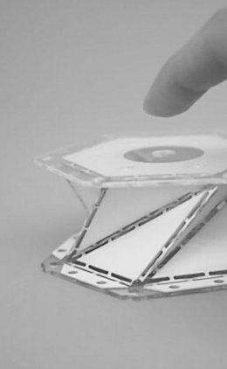
03
UNI SANS
Open sans body Open sans body Open sans body Open sans body
ENCODE SANS HEADING
UNI SANS
Open sans body Open sans body Open sans body Open sans body
UNI SANS
Open sans body Open sans body Open sans body Open sans body

Slide 42
break

Slide 43
ENCODE SANS
UNI SANS SUBHEADING
UW AERO AND ASTRO
pg 01 / 22

Slide 44
UNI SANS
UNI SANS
ENCODE SANS
Open sans
Open sans
Open sans
Open sans
Open sans
Open sans
Open sans
Open sans
Open sans
Open sans
03
07
08
09
11
13
14
15
16
17

Slide 45
UNI SANS
UNI SANS
OPEN SANS BOLD
Encode sans heading
UNI SANS SUBHEADING

Slide 46
UNI SANS
UNI SANS
OPEN SANS BOLD
Encode sans heading
UNI SANS SUBHEADING
Open sans body Open sans body Open sans body Open sans body Open sans body Open sans body Open sans body Open sans body Open sans body Open sans body Open sans body Open sans body Open sans body Open sans body Open sans body Open sans body Open sans body Open sans body

Slide 47
UNI SANS
UNI SANS
OPEN SANS BOLD
ENCODE SANS
Open sans body Open sans body Open sans body Open sans body Open sans body Open sans body Open sans body Open sans body Open sans body Open sans body Open sans body Open sans body Open sans body Open sans body Open sans body Open sans body Open sans body Open sans body Open sans body Open sans body Open sans body Open sans body Open sans body Open sans body Open sans body Open sans body Open sans body
Open sans body Open sans body Open sans body Open sans body Open sans body Open sans body Open sans body Open sans body Open sans body
ENCODE SANS
Open sans body Open sans body Open sans body Open sans body Open sans body Open sans body Open sans body Open sans body Open sans body

Slide 48
UNI SANS
UNI SANS
OPEN SANS BOLD
ENCODE SANS HEADING
UNI SANS
UNI SANS
UNI SANS

Slide 49
break

Slide 50




ENCODE SANS HEADING
UNI SANS SUBHEADING

Slide 51

ENCODE SANS
Open sans body Open sans body Open sans body Open sans body Open sans body Open sans body Open sans body Open sans body Open sans body Open sans body Open sans body Open sans body Open sans body Open sans body Open sans body Open sans body Open sans body Open sans body Open sans body Open sans body Open sans body Open sans body Open sans body Open sans body Open sans body

Slide 52


ENCODE SANS
UNI SANS SUBHEADING
Open sans body Open sans body Open sans body Open sans body Open sans body Open sans body Open sans body Open sans body Open sans body Open sans body Open sans body Open sans body Open sans body Open sans body Open sans body Open sans body Open sans body Open sans body Open sans body Open sans body Open sans body Open sans body Open sans body Open sans body Open sans body

Slide 53

ENCODE SANS
ENCODE SANS
Open sans body Open sans body Open sans body Open sans body Open sans body Open sans body Open sans body
Open sans body Open sans body Open sans body Open sans body Open sans body Open sans body Open sans body
ENCODE SANS
ENCODE SANS
Open sans body Open sans body Open sans body Open sans body Open sans body Open sans body Open sans body
Open sans body Open sans body Open sans body Open sans body Open sans body Open sans body Open sans body

Slide 54
ENCODE SANS
ENCODE SANS
ENCODE SANS
Open sans body Open sans body Open sans body Open sans body Open sans body Open sans body Open sans body
Open sans body Open sans body Open sans body Open sans body Open sans body Open sans body Open sans body
Open sans body Open sans body Open sans body Open sans body Open sans body Open sans body Open sans body

Slide 55
break

Slide 56
ENCODE SANS
UNI SANS SUBHEADING

Slide 57
UNI SANS
Open sans body Open sans body Open sans body Open sans body
Encode sans heading
UNI SANS
Open sans body Open sans body Open sans body Open sans body

Slide 58



Encode sans heading
UNI SANS
UNI SANS
UNI SANS
Open sans body Open sans body Open sans body Open sans body
Open sans body Open sans body Open sans body Open sans body
Open sans body Open sans body Open sans body Open sans body

Slide 59
Encode sans heading
01
Uni Sans
02
Uni Sans
Open sans body Open sans body Open sans
Open sans body Open sans body Open sans
03
Uni Sans
04
Uni Sans
Open sans body Open sans body Open sans
Open sans body Open sans body Open sans

Slide 60
50
40
Encode sans
30
20
Opens sans body Open sans body Open sans body
10
0
Item 1
Item 2
Item 3
Item 4
Item 5

Slide 61

Encode sans
Open sans body Open sans body

Slide 62
break

Slide 63

Encode Sans
Heading
Open sans
UNI SANS SUBHEADING
NEXT

Slide 64
OPEN SANS
01
UNI SANS
Encode sans heading
02
UNI SANS
UNI SANS SUBHEADING
03
UNI SANS
NEXT

Slide 65



Open sans
01
Open sans
UNI SANS
Open sans

Slide 66
Encode sans heading
Open sans body
Open sans body
Open sans body

Slide 67
1
2
Encode sans
Open sans body Open sans body Open sans body Open sans body. Open sans body
Open sans body Open sans body Open sans body Open sans body. Open sans body
3
4
Open sans body Open sans body Open sans body Open sans body. Open sans body
Open sans body Open sans body Open sans body Open sans body. Open sans body
NEXT

